Slide 1

The social and economic value of
volunteers in WA
Professor Kirsten Holmes
Associate Professor Amanda Davies
Associate Professor Leonie Lockstone-Binney (Presenting)
June 21st 2019

Slide 2

Background
Rural communities typically are more reliant on volunteers to deliver essential and non-essential community services
For some communities, there are no alternatives to volunteer provided services
Data on volunteer efforts in Australia are spatially and organisationally incomplete
Existing data does not enable identification of the frequency and intensity of volunteer participation
Fragmented evidence across the sector of volunteer shortages and volunteer burnout in rural communities

Slide 3
Study objectives
To identify the volunteering participation rate in rural WA and characteristics of the volunteering workforce
To identify the contemporary experiences of rural volunteer involving organisations and groups in recruiting and retaining volunteers
To understand how and why rural volunteers become involved in volunteering and document the strategies they use to manage their volunteering participation over the life course
To document supply-side vulnerabilities of the rural volunteering workforce and identify potential measures to address these

Slide 4
Methods
Sequential mixed-methods approach:
WA Department for Regional Development’s 2013 Living in Regions Survey (LITR) analysed - 6,666 respondents had volunteered in the past 3 months
LITR data used to identify case study LGAs of Bridgetown-Greenbushes (B-G) and Boyup Brook (BB) (located in Southwest WA)
Database of volunteer involving organisations in these regions compiled (n=177)
Face-to-face interviews with 11 organisational representatives conducted
Online survey to database (n = 55)
Face-to-face interviews with 17 volunteers conducted
Notes:
Bridgetown-Greenbushes and Boyup Brook LGAs selected as typical cases of many rural communities across Australia – experiencing structural ageing, limited growth prospects, economies tied to agriculture and mining.
Bridgetown-Greenbushes LGA comprised:
Bridgetown – decline in timber production, area in recent years attracted lifestyle in-migrants, 1.5 hours from Bunbury, students wanting to complete YR10 or above must commute or board
Greenbushes (20 mins from Bridgetown and Boyup Brook) – Lithium mine, heavily dependent on mining – recent expansion of mine is attracting new residents
Boyup Brook – traditional farming community, population has remained stable over the last decade

Slide 5
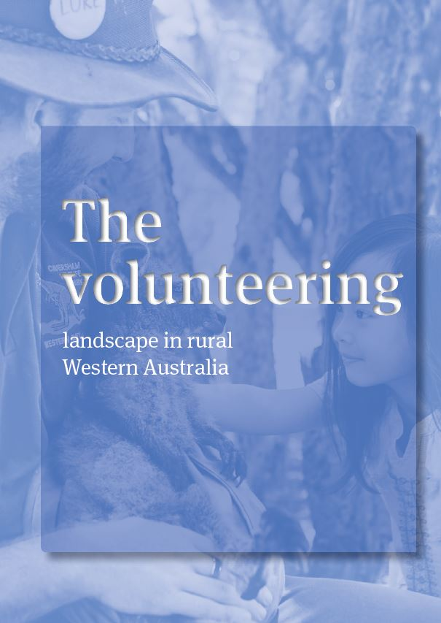
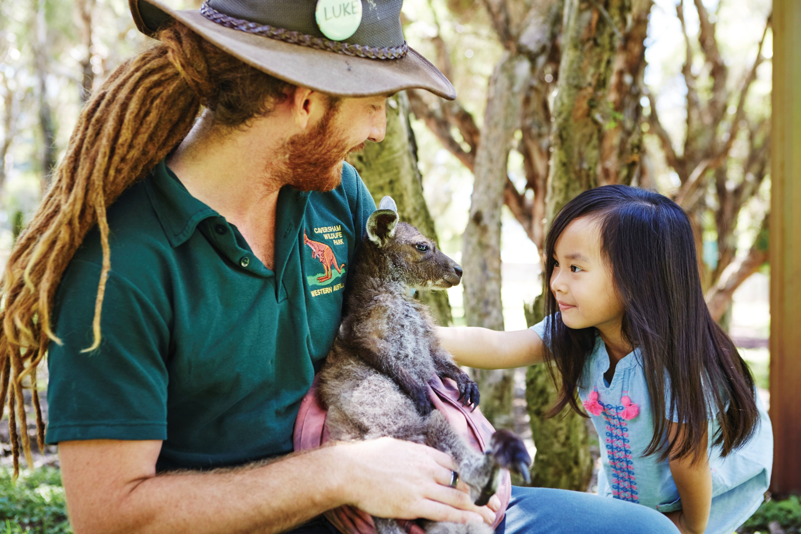

Slide 6
LITR Survey - What the numbers tell us…
High volunteering in rural WA (more than 60% of those aged over 29 years)
More than 80% of farmers and 70% of small business owners volunteered
Those with primary school aged children very active in volunteering
Numbers likely to underestimate - volunteering not regarded as ‘volunteering’
23% of active volunteers planning on moving away from their community within 10 years.
Key reason for moving – limited services and facilities in rural communities

Slide 7
Profile of case study regions
Volunteering rates high:
  B-G = 26.3%
  BB = 29.3%
  Greater Perth= 14.5%
Median age of population rising:
  B-G = 44 (2006) to 49 (2016)
  BB = 43 (2006) to 49 (2016)
  Greater Perth = 36 (2006) to 36 (2016)
  (ABS, 2007, 2013, 2017)
Notes:
Data from ABS Australian Population and Housing Census

Slide 8
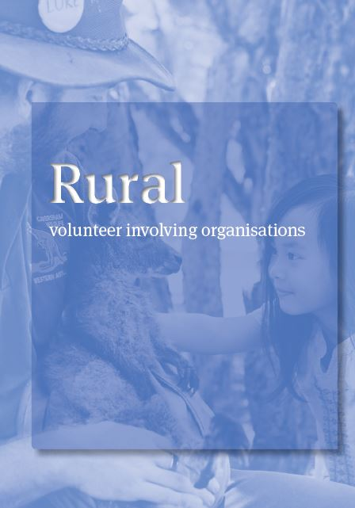
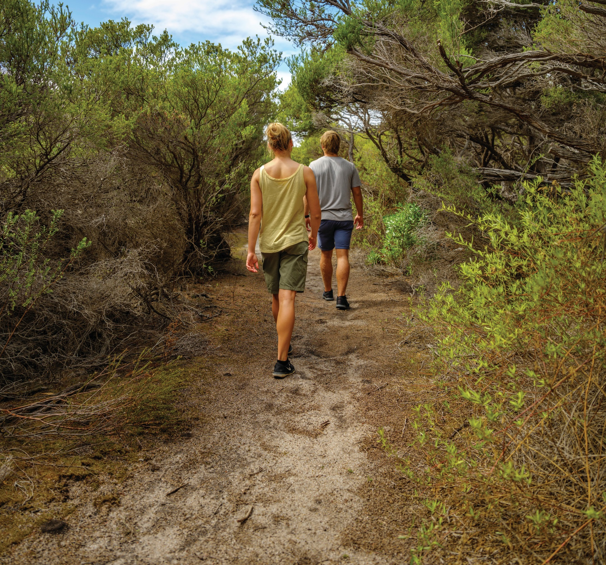
Notes:
Provides insights about the nature, challenges and future of rural volunteer involving organisations from the perspective of those running them day-to-day

Slide 9
Volunteers central to rural communities surviving and thriving
“Your general rule is that everyone is doing at least 1 if not 2 or 3 things from the golf club to ambulance to firies…”

Slide 10
Challenges facing rural volunteer involving organisations
Increased accountability and regulation e.g., training, safety checks, etc.
  Some interviewees viewed this professionalisation of volunteering favourably
ICT advances e.g., increase in training and support offered at a distance
‘Saturation’ of volunteer labour pool
Recruiting new volunteers was an ongoing issue:
  40% of respondents to the organisational survey indicated they currently had volunteer shortages
  Difficult to recruit young people into volunteering, exacerbated by the lack of local schooling
  Organisations relying on a small core group of volunteers
Notes:
Internet connectivity and familiarity an issue in some cases
1 Increased, training, safety practices, liability and government oversight.
Benefits – increased efficiency but can hamper organisation and discourage volunteers
Technology Changed communication and some activities (e.g. online not face to face)
Volunteer training increasingly delivered online but limited opportunity to make social connections
Funding - often relied on contributions from vols. Access to grants harder – more complex forms for all vol orgs, no of grants decreased (esp as Royalties for Regions changed). Inconsistent grant environment = look for funds elsewhere. Trad fundraising harder due to regulation (e.g. no cream at cake stalls; rules around raffles); raise funds by providing service to other VIO
Factors affecting recruitment = access to sufficient funding for org; type of group/ org; and demographic of local area. E.g. Greenbushes community garden catalyst for growth in volunteering and VIOs
volunteer leaders getting older but hard to find someone to take over. Claim was young people unwilling but young people not there – lack of schooling. Work and family pressures harder for working age to take on roles. Perception don’t have the expertise as more regulation etc
Succession - usually up to the individual; hard to find committee members/ officers especially. Core and periphery vols – how to replace core vols? Reliance on this group = vulnerable community esp if demand for services grows

Slide 11
Challenges facing rural volunteer involving organisations
Dominant feeling volunteering was not appropriately recognised or funded by government
Difficult for organisations to obtain funding:
  Decreasing funding sources and complex grant applications
  Regulations affecting fundraising efforts
Some evidence of new funding sources e.g., catering and gate attendance
Flow on effects of cutting back services or ceasing operations
44% of survey respondents indicated that they were concerned about the sustainability of their local community
Notes:
Regulations affecting fundraising efforts e.g., cake stalls – all food items for sale required to include a complete ingredient list for those with allergies

Slide 12
The individual volunteer experience
Managing the volunteer workload
Obligation to volunteer and risk of burnout
Increased accountability and regulation
Stressful volunteer roles
Notes:
Workload – Managing vol, work, family, leisure. Serial volunteers whose commitments varied over lifecourse. Seasonal pressures from work. Vol work falling to ‘core group’, who have multiple roles competing for their time (e.g. ‘another Monday night’). Need for turnover of committee members – avoid becoming stale
Obligation and burnout – Vol a way of life in rural WA, something you just do as otherwise doesn’t happen – sense of responsibility but risk of burnout for core vols. Expected they will continue in committee roles but are they all needed?
Accountability - Level of training required = discourages new vols. Changed nature of volunteering, but has also improved some processes
Stressful vol roles – Acknowledge that some roles – esp emergency services – were inherently stressful roles regardless of additional stress from external or internal forces. Places restrictions on vols – e.g. can’t take holidays away during peak fire season. Interviewees suggested intensity of commitment meant vols could only stay for limited time.

Slide 13
Avoiding burnout – Coping strategies
Surprisingly little evidence of burnout in the case study communities
Individual volunteers skilled at avoiding burnout by:
  Combining volunteering with other commitments
  Establishing boundaries and saying ‘no’
  Personal interest sustaining volunteering
  Adopting a flexible and adaptable approach
Notes:
Combining – Individuals vol where family takes them – e.g. sport club so no conflict – or school – or combine with work. Shows how fundamental vol is to community
Boundaries – Be clear what prepared to do and enforce these boundaries. Set aside time for vol. Learning when to say ‘no’, actively reject further involvement if role becomes tedious or too much. Turn down requests for more help. VIOs may need to change if can’t recruit
Personal interest – attracts vols and sustains their interest, .e.g set up toy library which would benefit children. Also helps build social networks
Flexible – flexible in, adaptable mentally, keep perspective on vol role; go with flow, accept changes, able to learn new skills and processes

Slide 14
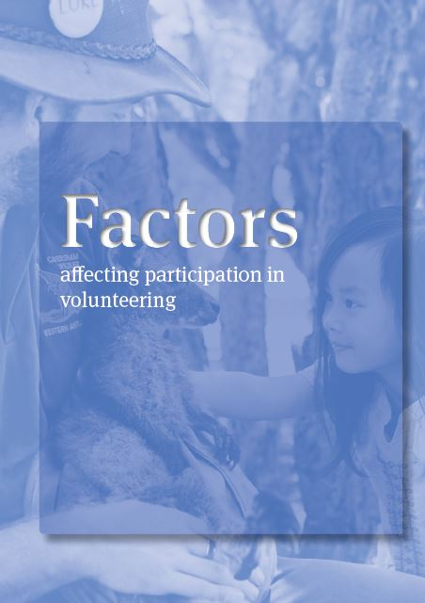
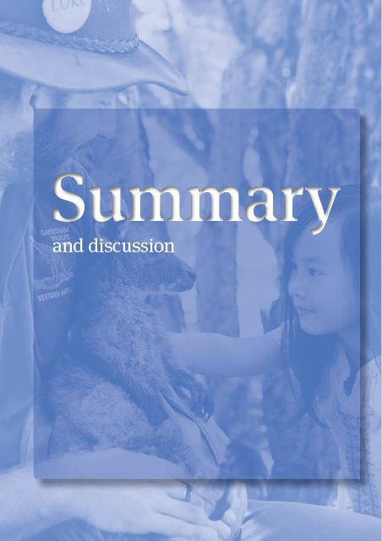


Slide 15
Key takeaways
Volunteering a way of life in rural areas but multiple commitments
Limited scope to grow number of volunteers without in-migration
Recruitment needs to consider demographics of local area
Potential to segment different groups of volunteers based on their personal interests
Positively, core volunteers appear to actively manage their volunteering portfolio to avoid burnout and the subsequent reduction of the volunteer pool in their community
Many volunteer involving organisations have no strategies for recruitment or succession planning
Notes:
Positives – opportunity to streamline work.

Slide 16
Organisational recommendations
Greater use of strategic planning processes to guide volunteer labour recruitments, training, retention and succession planning
Larger centrally located volunteer-involving organisations audit their operations to ensure volunteers managed at a distance are supported
Rural volunteer-involving organisations proactively manage the workload of their volunteers (e.g., set terms for committee members)
Volunteer-involving organisations work with employers to support their staff to meet the demands of volunteering commitments (e.g., emergency firefighters)
Notes:
Many of these are wicked problems that cannot be systematically addressed by volunteers or volunteer-involving organisations alone.
This could include flexible rostering or use of employers’ resource and equipment

Slide 17

Thank you
We wish to thank:
The Bankwest Curtin Economics Centre
Government of Western Australia’s Department for Regional Development (now part of the Department for Primary Industries)
Download the report for free at: https://bcec.edu.au/publications/the-social-and-economic-sustainability-of-was-rural-volunteer-workforce/
Contact me at: l.lockstone-binney@griffith.edu.au

